Slide 1
R package building and R GUI building
Chen Hao
29 Sep 2014

Slide 2
Why packages? R is mostly packages!
R ships with 13 base packages, and 15 recommended packages.
CRAN contains about 5000 packages, Bioconductor has about 1600.
There are other repositories (R-forge, Omegahat, rforge.net, etc.) and packages not in these repositories.
Notes:
What is in a package?
A package bundles together code, data, documentation and tests, and it’s easy to share with others.
Permanent R objects: functions, data, etc.
Help pages and vignettes documenting these objects.
External code in C, C++, Fortran, Objective C, etc. to implement some of the functions, or link to external libraries or programs.
Tests to help to keep the code working as R evolves.

Slide 3
The Structure of a R package
pkgName (the name of your package)
|
|----DESCRIPTION
|---- NAMESPACE
|---- R (R source codes)
|---- function1.R
|---- function2.R
|---- ...
|---- man (help documentss)
|---- function1.Rd
|---- function2.Rd
|---- ...
|---- vignettes
|---- data (rda data)
|---- demo (demo R codes)
|---- src (code of other language)
|---- inst (will remain in the root dir of the pkg)
|---- doc (store the vignettes )
Notes:
most commonly used components:
R/: where your R code lives in .R files
DESCRIPTION: metadata about the package
man/: function documentation
vignettes/: long-form documentation which show how to combine multiple parts of your package to solve real problems.
NAMESPACE: ensures that your package plays nicely with other packages.
tests/: stores unit tests that ensure that your package is operating as designed.
data/: sample datasets (or other R objects)
src/: compiled C, C++ and Fortran source code

Slide 4
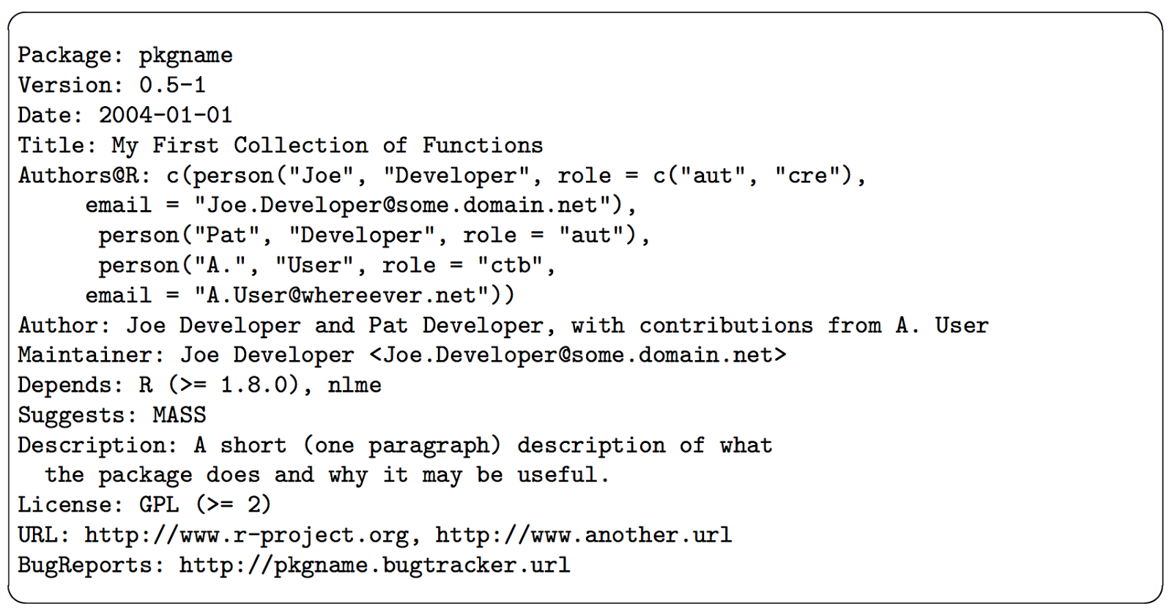
DESCRIPTION
Notes:
Every package must have a DESCRIPTION. In fact, it’s the defining feature of a package. DESCRIPTION uses a simple file format called DCF, the Debian control format. You can see most of the structure in the simple example below. Each line consists of a field name and a value, separated by a colon. When values span multiple lines, they need to be indented.
The ‘Package’, ‘Version’, ‘License’, ‘Description’, ‘Title’, ‘Author’, and ‘Maintainer’ fields are mandatory, all other fields are optional. Fields ‘Author’ and ‘Maintainer’ can be auto-generated from ‘Authors@R’, and may be omitted if the latter is provided
The mandatory ‘Package’ field gives the name of the package. This should contain only (ASCII) letters, numbers and dot, have at least two characters and start with a letter and not end in a dot.
The mandatory ‘Version’ field gives the version of the package. This is a sequence of at least two (and usually three) non-negative integers separated by single ‘.’ or ‘-’ characters. The canonical form is as shown in the example, and a version such as ‘0.01’ or ‘0.01.0’ will be handled as if it were ‘0.1-0’. It is not a decimal number, so for example 0.9 < 0.75 since 9 < 75.
The mandatory ‘License’ field is discussed in the next subsection.
The mandatory ‘Description’ field should give a comprehensive description of what the package does. One can use several (complete) sentences, but only one paragraph.
The mandatory ‘Title’ field should give a short description of the package. Some package listings may truncate the title to 65 characters. It should be capitalized, not use any markup, not have any continuation lines, and not end in a period.
The mandatory ‘Author’ field describes who wrote the package. It is a plain text field intended for human readers, but not for automatic processing (such as extracting the email addresses of all listed contributors: for that use ‘Authors@R’). Note that all significant contributors must be included: if you wrote an R wrapper for the work of others included in the src directory, you are not the sole (and maybe not even the main) author.
The mandatory ‘Maintainer’ field should give a single name followed a valid (RFC 2822) email address in angle brackets. It should not end in a period or comma. This field is what is reported by the maintainer function and used by bug.report. For a CRAN package it should be a person, not a mailing list and not a corporate entity: do ensure that it is valid and will remain valid for the lifetime of the package.
The ‘Depends’ field gives a comma-separated list of package names which this package depends on. Those packages will be attached before the current package when library or require is called. Each package name may be optionally followed by a comment in parentheses specifying a version requirement.

Slide 5
R/
While it’s free to arrange functions into files as you wish, the two extremes are bad:
don’t put all functions into one file
don’t put each function into its own separate file.
One big difference between a script and a package is that the code in a package should not have side effects. Your code should only create objects (mostly functions), and you should not call functions that affect the global state:
Don’t use library() or require(). Use the DESCRIPTION to specify you package’s requirements.
Don’t modify global options() or graphics par(). Put state changing operations in functions that the user can call when they want.
Don’t save files to disk with write(), write.csv(), or saveRDS(). Use data/ to cache important data files.
Notes:
While you’re free to arrange functions into files as you wish, the two extremes are bad: don’t put all functions into one file and don’t put each function into its own separate file.
you can’t use subdirectories inside in R/.

Slide 6
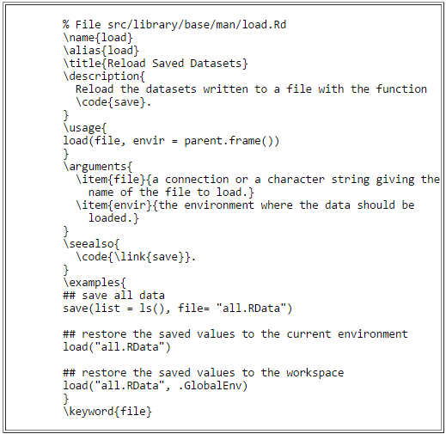
man/ -- R Documents
Notes:
Documentation
these files use a custom syntax, loosely based on LaTeX, and are rendered to HTML for viewing.

Slide 7
NAMESPACE

Slide 8
src/
在src目录下我们可以放置一些其它语言的源代码，里面可能包含一些函数，这些函数在被编译之后，（以C语言为例）可以在R代码中以.C('routine_name', ..., package = 'pkg')的形式调用，但要注意，如果需要用这个功能，在R目录下需要有一个zzz.R文件（这个特殊文件是用来在加载包之前加载运行的代码），里面写上：
.onLoad <- function(lib, pkg) { library.dynam("pkg_name", pkg, lib) # pkg_name是你的包的名字 }

Slide 9
vignettes/
Vignettes are documentation in R packages that may include R code. The code is run when the vignette is “woven”, and the code can be extracted when the vignette is “tangled”. The vignette source is in the vignettes directory of the package.
Vignettes are considered to be part of R’s help system. The help system will display their title, and links to the PDF, source, and extracted R code. This is based on some special “meta-data” included in the source.
They are the best way to present an overall introduction to a package.
They can give technical details about how a package was implemented.
They can demonstrate particular aspects of the package.
Once happy with the report, you can use devtools::build_vignettes() to generate the vignette files that will be copied to the relevant locations(inst/doc: the output vignette)
Notes:
For packages hosted by CRAN, vignettes are an optional component. However, the Bioconductor project requires thatvignettes be included in each package.
Prior to R 3.0, one generally had to write vignettes using sweave, a combination of latex and R code that generates a PDF file. However, since v3.0, it is possible to write vignettes using R markdown (and actually some other markup formats), which generates HTML output. The advantages to using R markdown over sweave are that the syntax for writing markdownis much simpler, and much more readable in it's raw format.

Slide 10
Any tools to make this automatically
Traditional way
可以用package.skeleton() 生成pkg骨架
Never use package.skeleton() to create a package. It’s designed for an older era of package development, and mostly serves to make your life harder, not easier.
或者prompt()等函数来辅助生成Rd文件
若你的包只有一两个函数，倒也无妨，轻松写写完事，要是你想维护30个函数，那你就会觉得这种做法完全是坑爹。坑爹之处不仅在于你要么手敲这些命令要么绕道用函数生成文档模板自己填充，更在于你得在man文件夹下维护R文件夹下的函数的文档！你每次更新R函数，都得战战兢兢记住了：还有man文件夹下的某个*.Rd文件也许需要更新。
Notes:
The most accurate resource for up-to-date details on package development is always the official writing R extensionsguide. However, it’s rather hard to understand if you’re not already familiar with the basics of packages. It’s also exhaustive, covering every possible package component, rather than focussing on the most common and useful components as this book does. Writing R extensions is a useful resource once you’ve mastered the basics and need to check on more esoteric facts.
Developing packages with devtools may take some getting used to. However, I strongly believe that the time invested in mastering it will, in the long run, save you much, much more time. Devtools is a key component of my productivity in package development.
Devtools works hand-in-hand with RStudio, which I believe is the best development environment for most R users. The only real competitor is ESS, emacs speaks statistics, which is a rewarding environment if you’re willing to put in the time to learn emacs and customise it to your needs.

Slide 11
Rstudio and devtools
Philosophy of package development:
anything that can be automated, should be automated. Do as little as possible by hand.
--- Hadley Wickham

Slide 12
Requirements for building your package
To get started, make sure you have the latest version of R (at least 3.1.0, which was current when I wrote this book), then run the following code to get the packages you’ll need:
install.packages(c("devtools", "roxygen2", "testthat", "knitr"))
You’ll also need to make sure you have a C compiler and other needed command line tools. If you’re on Windows or Mac and you don’t already have them, RStudio will install them for you. Otherwise:
On Windows, download and install Rtools. NB: this is not an R package!
On Mac, make sure you have either XCode (available for free in the App Store) or the “Command Line Tools for Xcode”. NB: you’ll need to have an Apple ID (available for free).
On Linux, make sure you’ve installed not only R, but the R development devtools. This is a Linux package called something like r-base-dev.

Slide 13
Getting started
The easiest way to get started with a package is to run:
install.packages('devtools',dependencies=T)
devtools::create("path/to/package/pkgname")
This makes the package directory, path/to/package/pkgname/, and adds four items to make the smallest usable package:
An RStudio project file, pkgname.Rproj.
An R/ directory.
A basic DESCRIPTION file.
A basic NAMESPACE file.
Notes:
To get started with your new package in RStudio, double-click the package.Rproj file that create() just made. This will open a new RStudio project for your package. Projects are a great way to develop packages.
The first advantage of using a package is that it’s easy to re-load your code. There are two main options:
devtools::load_all(), Cmd + Shift + L, reloads all code in the package. In RStudio, this also saves all open files, saving you a keystroke.
Build & reload, Cmd + Shift + B. This is only available in RStudio. It installs the package, restarts R, and then reloads the package with library() (doing this by hand is painful).
These commands make your development workflow more fluid:
Edit R files in the editor.
Press Cmd + Shift + L (or Cmd + Shift + B).
Explore the code in the console.
Rinse and repeat.

Slide 14
Build the package
Four types of packages:
Source -- the development version of a package that lives on your computer.
Bundled -- a package compressed into a single file. By convention, package bundles in R use the extension.tar.gz. This convention comes from Linux: it means that multiple files have been collapsed into a single file (.tar) and then compressed using gzip (.gz). Call devtools::build() to make a package bundle.
Binary -- Binary packages are platform specific: you can’t install a Windows binary package on a Mac or vice versa. Also, Mac binary packages end in .tgz and Windows binary packages end in .zip. You can use devtools::build(binary = TRUE)to make a binary package.
Installed -- An installed package is just a binary package that’s been decompressed into a package library.

Slide 15
Generating Rd files using Roxygen comments
#' title(one line)
#'
#' description (one paragraph)
#'
#' details here (any length you want)
#'
#' @param a
#' @param b
#' @return
#' @author abc <\url{http://abc.com}>
#' @examples
myFunction <- function(a, b){
return(a + b)
}
As well as generating `.Rd` files, `roxygen2` can also manage your `NAMESPACE` and the Collate field in `DESCRIPTION`. To do this, only two simple steps:
Add roxygen comments to your `.R` files.
Run devtools::document() on the R console (or press `Cmd + Shift + D` in RStudio) to convert roxygen comments to `.Rd` files.
Notes:
Documentation always seemed like the most intimidating step to me. I’m here to tell you — it’s super quick. The package roxygen2 that makes everything amazing and simple. The way it works is that you add special comments to the beginning of each function, that will later be compiled into the correct format for package documentation.
As well as generating `.Rd` files, `roxygen2` can also manage your `NAMESPACE` and the Collate field in `DESCRIPTION`. To do this, only two simple steps:
1. Add roxygen comments to your `.R` files. (as the example above)
2. Run `devtools::document()` on the R console (or press `Cmd + Shift + D` in RStudio) to convert roxygen comments to `.Rd` files.

Slide 16
Resources
Writing an R package from scratch a blog by Hilary Parker
http://hilaryparker.com/2014/04/29/writing-an-r-package-from-scratch/
R packages a book by Hadley Wickham
http://r-pkgs.had.co.nz/
writing R extensions official documents
http://cran.r-project.org/doc/manuals/R-exts.html#Creating-R-packages

